Slide 1
NIPS 2017: Learning to Run
Reinforcement learning environments with musculoskeletal models
By Stanford Neuromuscular Biomechanics Laboratory

Slide 2
physics environment: opensim
State space:
a 41 dimensional vector
Contains: position: rotation,x, y
velocity: rotation,x,y
angle velocity
obstacle
Action space:
a 18 dimensional vector(9 per
leg),corresponds to all 18 muscles
range: continuous values in [0, 1]

Slide 3
physics environment: opensim
Total reward:
the position of the pelvis on the
x axis after the last iteration(no
more than 1000 steps)
MINUS
a penalty for using ligament
forces

Slide 4
The official method to learn the model
Algorithm:
DDPG : Deep Deterministic Policy Gradients, by Google Deepmind
Property: Off policy with a replay buffer
Neural network:
two networks for actor and critic Respectively:
about 4 to 6 hidden layers (all are fully-connected layers) used relu,
every layer has 256~128 units. the output layer is a tanh layer

Slide 5
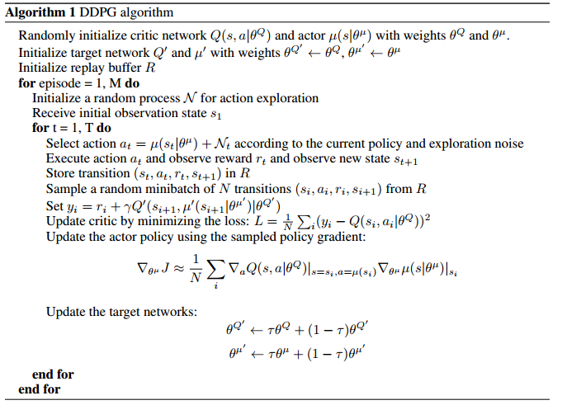
The official method to learn the model
DDPG : DQN + Actor-Critic

Slide 6
the problem of training with the official method
1、the simulator is extremely slow, so it is very important to
modify the single thread algorithm to a multiprocessing
version, like A3C, and it took a long time
2、a major challenge of learning in continuous action space is
exploration , DDPG achieves this by adding noise sampled
from a noise process to the actor policy
3、the actor-critic method means that convergence is not
guaranteed. So good hyperparameters are Critical

Slide 7
Another algorithm for continuous control tasks
1、TRPO(by openAI)
2、 PPO(by openAI, 2017.7,solved the problem of learning rate)
DPPO(by deepmind,2017.7, distributed ppo)
3、ACKTR(by openAI, 2017.8)
Property: policy Optimization 、on policy、actor-critic

Slide 8
other Participants’s experience
1、the PPO seems to be a better choice since it is efficient and
easy to run in multithreading
2、hop is a good gait (because of the penalty for using
ligament forces)
3、preprocessing the state is very important

Slide 9
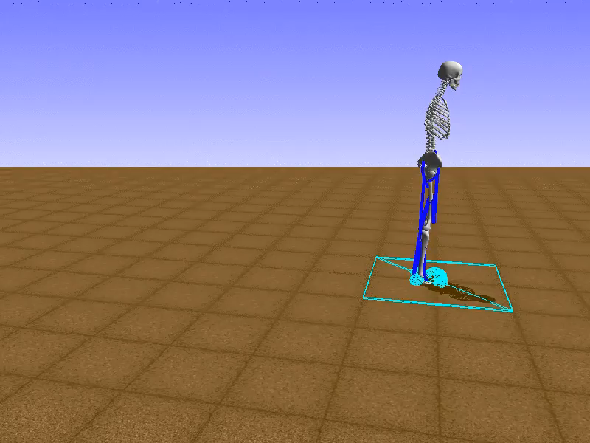
the leading performance: hop

Slide 10

the leading performance: run

Slide 11
have done and will do
1、the last month it took me a long time to get a multiprocessing version
DDPG algorithm, and finally I got one and used it to reach a score 19.34,
which ranks for 15th now, but it is hard for me to get a higher score
2、try to train a hop gait with DDPG by applying the same action on two
legs
3、try to revise the reward function
4、try to use the PPO/DPPO algorithm

